Slide 1
Bank Loan to Customers
Mentor (Shubham Kabre)
Group Number 4
Group members:
Bhargavi P
Aniket Jadhav
Shubham patil
Rajesh Bharati
Pavan kumar
Pankaj gupta
Rajesh jaggila
Kunal tondwalkar

Slide 2
In this project we are going to talk about the loans given by the bank to customers in various states of USA, their durations and purpose for which the loan was taken.
Year wise loan given to customers.
Grade and sub grade wise revolving balance.
Total Payment for verified status and total payment for non-verified status.
States wise and last credit pull date wise loan status.
Home ownership and last payment date stats.
(Visualization tools used are Tableau desktop and Power BI)

Slide 3
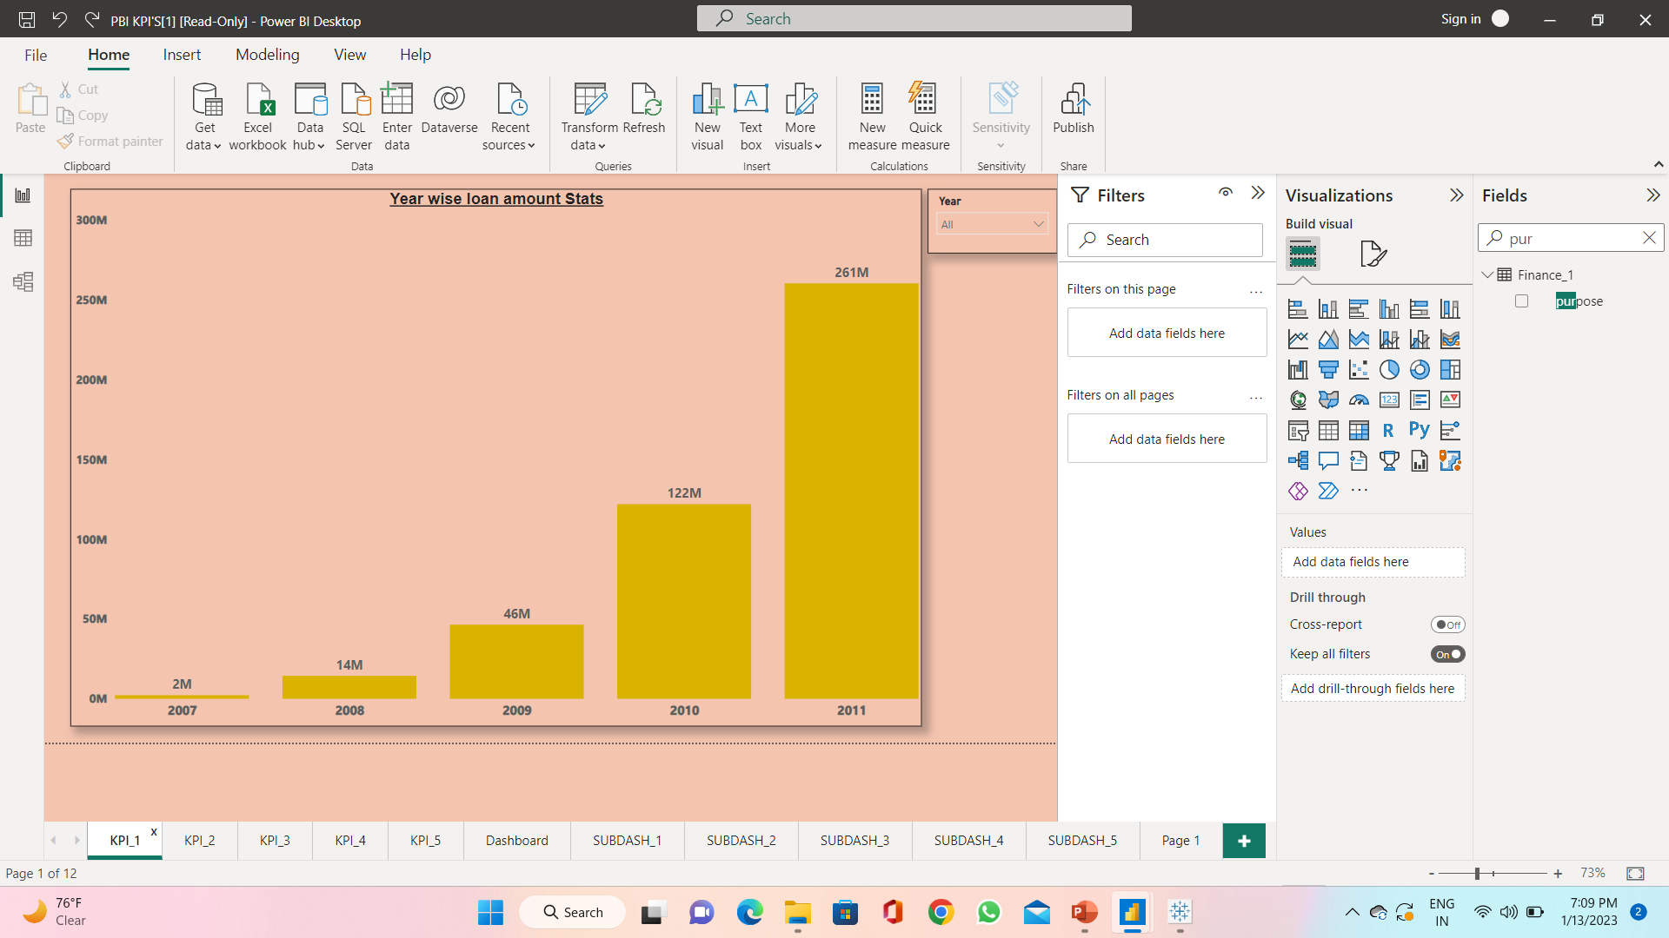
KPI 1 Year wise loan amount status
As we can see the loan amount is highest in the year 2011 around 261M.
Sum of total payment is increasing every year highest total payment is in the year 2011 which is around 290M.
In year 2011 the purpose of loan debt consolidation is 55% which is highest among other purposes.
In conclusion total payment, loan amount status is increasing every year.

Slide 4
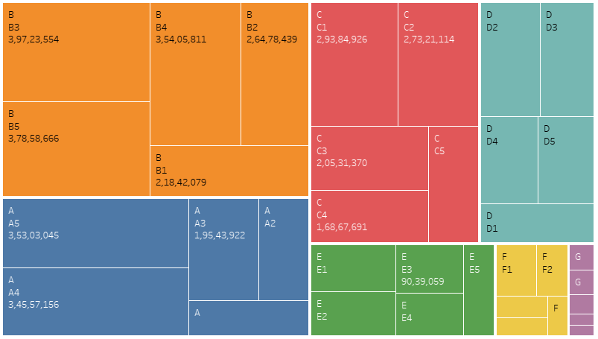
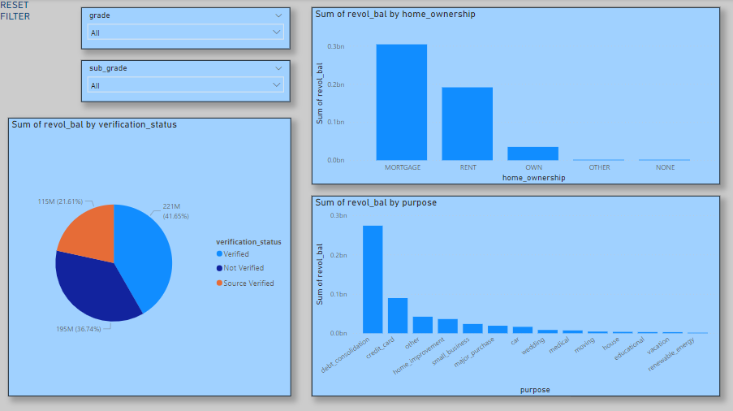
KPI 2 - Grade and sub grade wise revol_bal
The top right treemap chart shows us Grade and sub-grade wise revolving balance. Each grade represents a different colour and each box represents a sub-grade.
As seen from the treemap Grade B and sub-grade B3 has the highest revolving bal amounting to 3,97,23,554.
The bottom right chart shows us the sub-dashboard.
Loan taken for debt consolidation has the highest revol bal compared to other purpose.
Mortgage home ownership has the highest revol bal of 9,16,20,716.

Slide 5
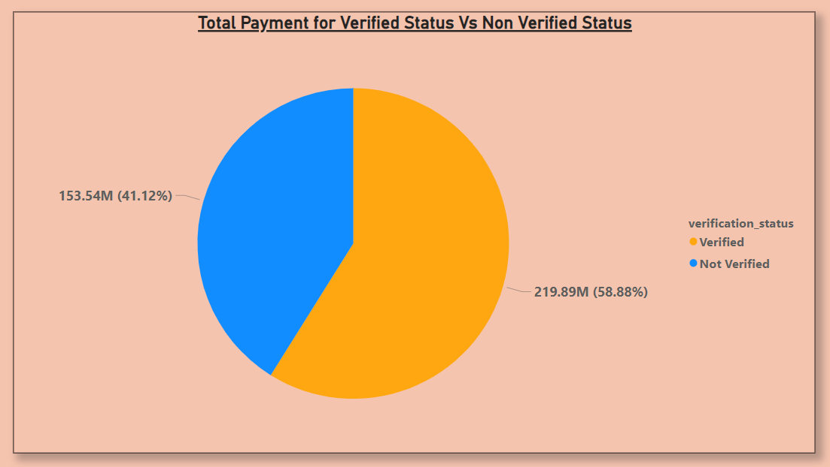
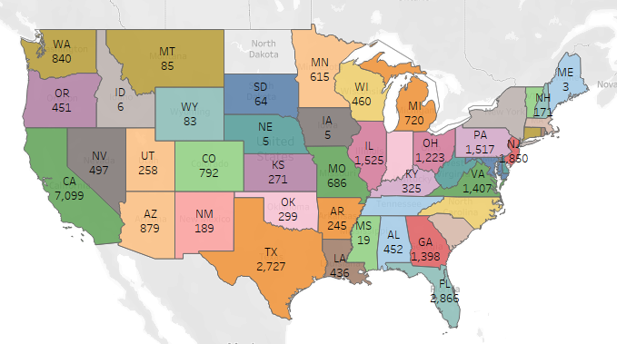
KPI 3 -Total Payment for Verified Status VS Non-Verified Status
Verified Payment Status for around 59% i.e., 220 million.
Major Purpose for Loan is debt consolidation which is around 57% for Verified Payment & 46% for Non-Verified.
Customers in California state having higher annual income which is around 20%.
California is the state with customer having highest verified payment status which is around 18%.
Also, the fully Paid Loan status of California state is much higher as compared to other states which is 83%.

Slide 6
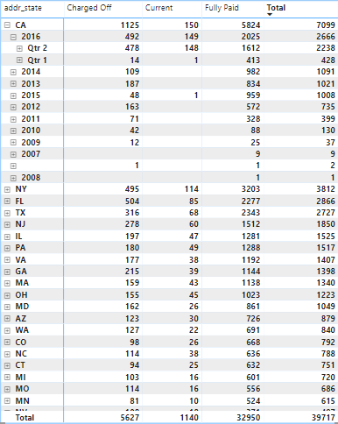
KPI 4 - State wise and last credit pull date wise loan status
The following chart shows sate wise and last credit pull date wise loan status.
California has the highest number of Fully paid Loan status 5,824 followed by New York 3,203.
California also has the highest number of count of charged off loan and current loan followed by New York.

Slide 7
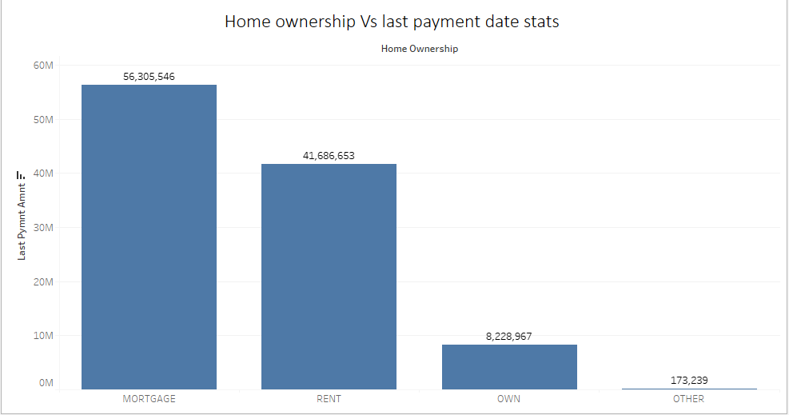
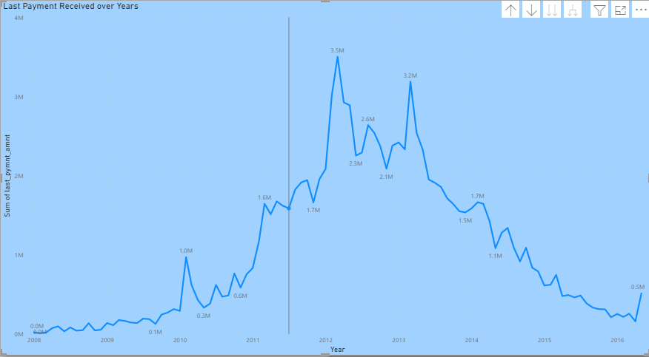
KPI 5 - Home ownership Vs last payment date stats
The last payment made by Mortgage home owners was highest compared to other home owners.
During March 2012 highest amount of last payment was received.

Slide 8
THANK YOU

